Slide 1

Factors Influencing Higher Income Levels

Slide 2

Data explores Income Based on
Age
Education
Hours worked per week

Slide 3

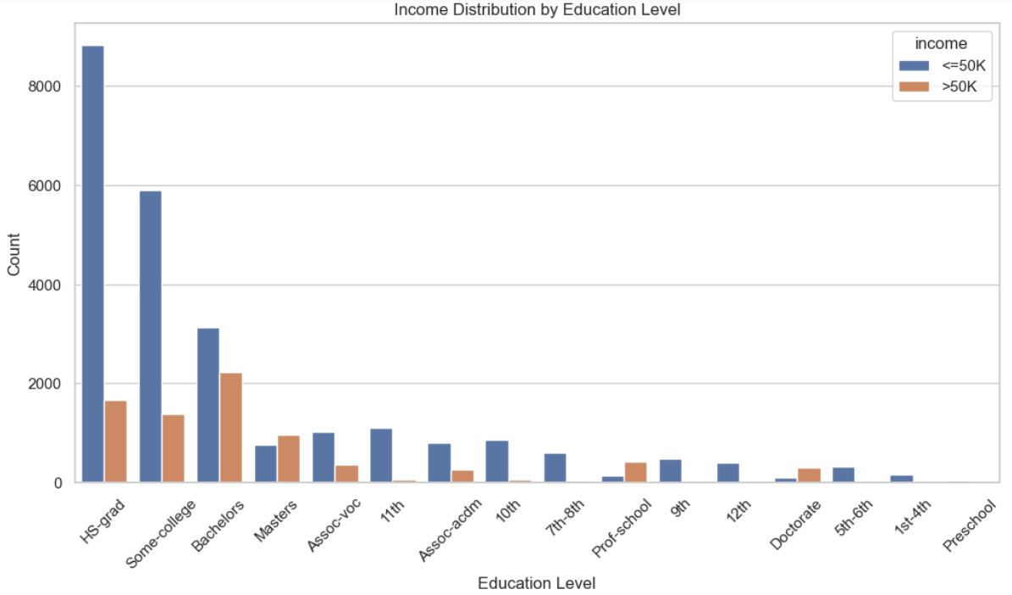
Education Level
Higher education levels are strongly associated with higher income

Slide 4
Income Distribution by Education Level
Higher education levels correlate strongly with higher income levels.
Individuals with advanced degrees (e.g., Doctorate, Masters) are more likely to earn above $50K.
Policy implication: Investing in higher education can be a strategic approach to increase workforce earnings.

Slide 5
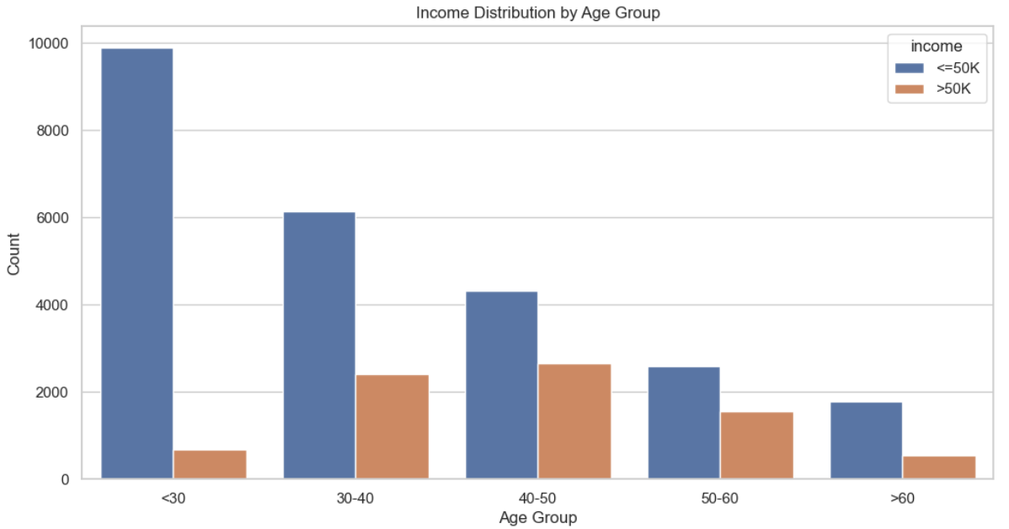
Middle-aged individuals are more likely to earn higher incomes

Slide 6

Income Distribution by Age Group
Middle-aged individuals (30-50) have the highest likelihood of earning more than $50K.
Younger (<30) and older (>60) individuals are less likely to earn higher incomes.
Workforce planning should consider targeting middle-aged employees for roles that require higher earnings.

Slide 7
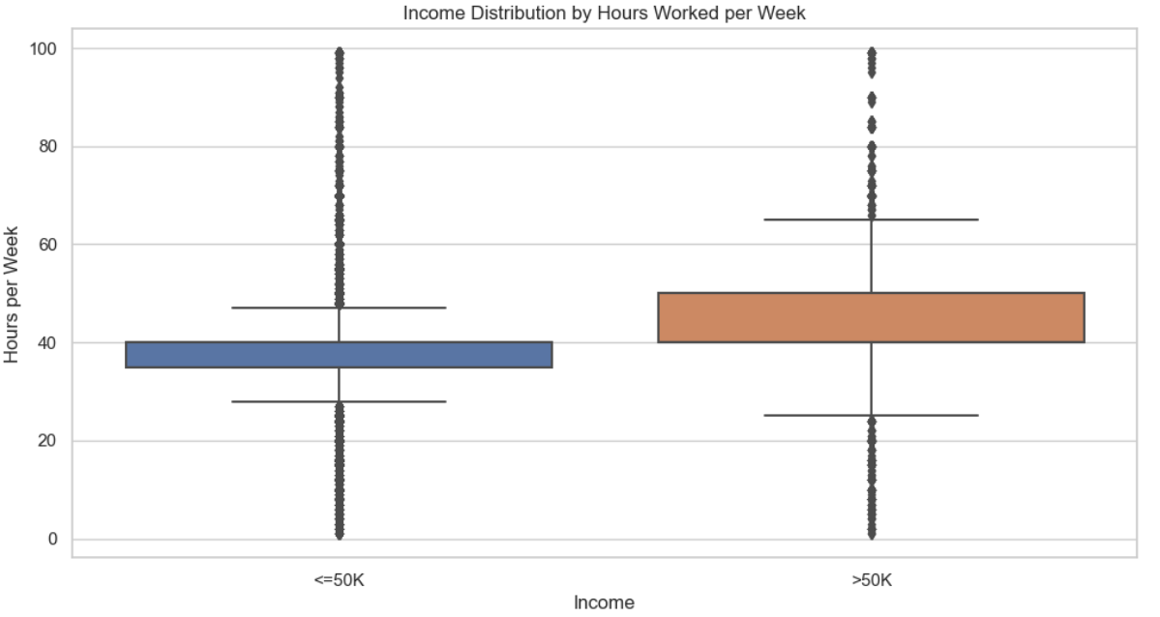
Hours Worked per Week
Working more hours is associated with higher income, up to a point.

Slide 8
Income Distribution by Hours Worked per Week
There is a positive correlation between the number of hours worked per week and income.
However, beyond a certain point, additional hours do not significantly increase income.
Work-life balance initiatives could be optimized to ensure productivity without excessive working hours.

Slide 9
Conclusion
Education Investment: Encourage and support continuing education programs to increase the number of employees with advanced degrees.
Targeted Recruitment: Focus recruitment efforts on middle-aged professionals who are statistically more likely to earn higher income.
Work Hours Management: Develop policies that optimize working hours to maintain productivity and employee well-being.

Slide 10

THANK YOU
Jesus Suarez

